Slide 1
UNIT-II: Fundamentals of Single Phase and Three Phase AC circuits

Slide 2
Unit – II: Fundamentals of Single Phase and Three Phase AC Circuits
Principle of AC voltage, waveforms & basic definitions.
R.M.S. and average values of alternative currents and voltage, Form factor and Peak factor.
Phasor representation of alternating quantities, the J operator and phasor algebra.
Analysis of ac circuits with single basic network element, Single phase series circuits.
Faraday’s laws of electromagnetic induction, concept of self and mutual inductances.

Slide 4


Slide 5
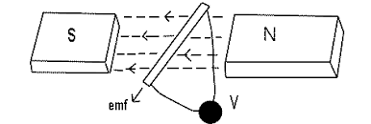
Faraday's Laws of Electro-Magnetic Induction
Faraday's laws of of electromagnetic induction explains the relationship between electric circuit and magnetic field.
Faraday's First Law: Whenever a conductor is placed in a varying magnetic field an EMF gets induced across the conductor (called as induced emf), and if the conductor is a closed circuit then induced current flows through it.
Magnetic field can be varied by various methods –(i) By moving magnet, (ii) By moving the coil and, (iii) By rotating the coil relative to magnetic field.

Slide 6
Faraday's second law of electromagnetic induction: states that, the magnitude of induced emf is equal to the rate of change of flux linkages with the coil.
The flux linkages is the product of number of turns and the flux associated with the coil. Where ‘-’ sign because of lenz’s law.
It is the fundamental operating principle of transformers, generators and induction machines based on faraday’s law of electromagnetic induction.

Slide 7
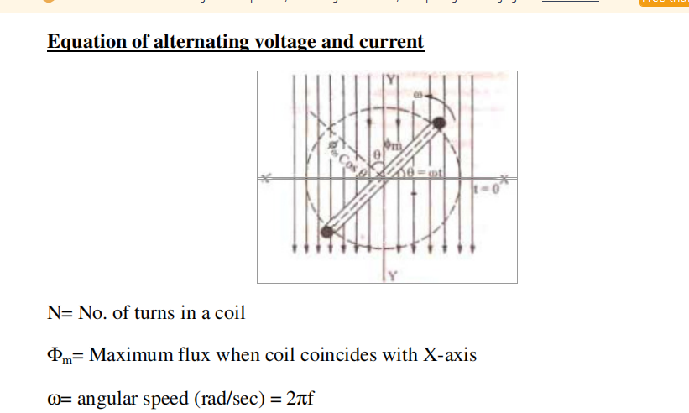
e = Em Sin ωt volt Now, current (i) at any time in the coil is proportional to the induced emf (e) in the coil. Hence, i = Im Sin ωt amp

Slide 8
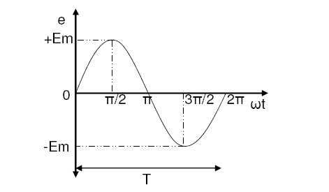
SINGLE PHASE AC CIRCUITS
An alternating quantity changes continuously in magnitude and alternates in direction at regular intervals of time.

Slide 9
1. Amplitude :
It is the maximum value attained by an alternating quantity. Also called as maximum or peak value
2. Time Period (T) :
It is the Time Taken in seconds to complete one cycle of an alternating quantity
3. Instantaneous Value :
It is the value of the quantity at any instant
4. Frequency (f) :
It is the number of cycles that occur in one second.
The unit for frequency is Hz or cycles/sec.
The relationship between frequency and time period can be derived as follows.
Time taken to complete f cycles = 1 second
Time taken to complete 1 cycle = 1/f second
T = 1/f

Slide 10
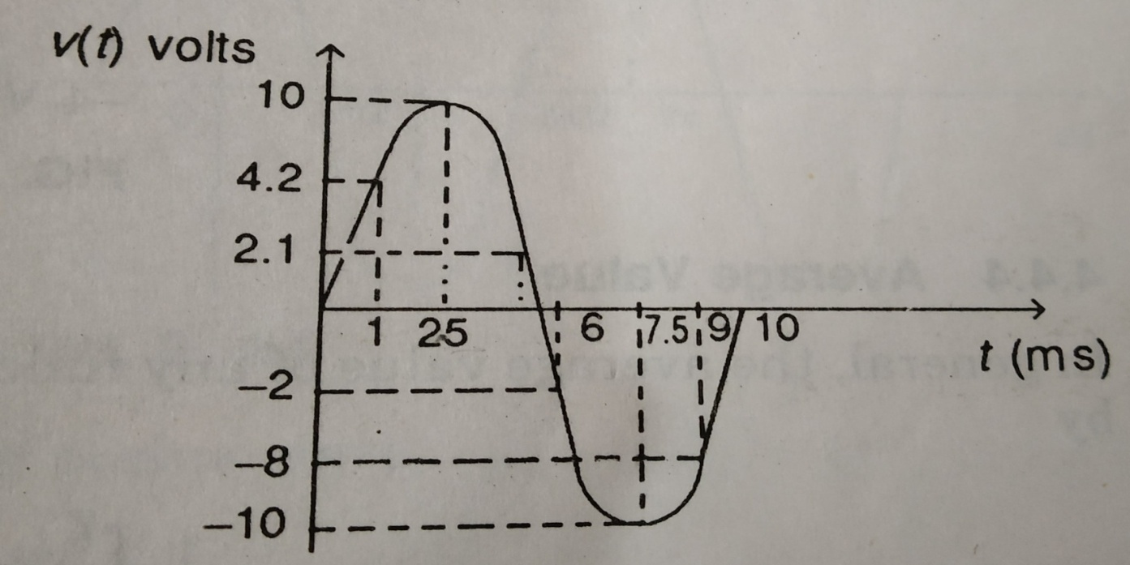
Instantaneous Value
The above figure shown at time 1 ms, the instantaneous value is 4.2 V; the value is 10 V at 2.5ms, -2 V at 6ms and -10 V at 7.5 ms and so on.
At any given time, the voltage or current has some instantaneous values.

Slide 11
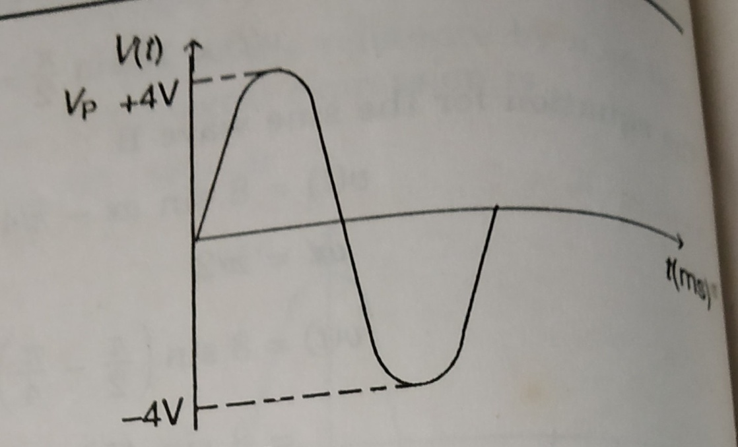
(II) Peak Value
The peak value of the sine wave is the maximum value of the wave during the positive half cycle or maximum value of wave during the negative half cycle.
The peak value of the sine wave is shown in the figure is 4V.

Slide 12
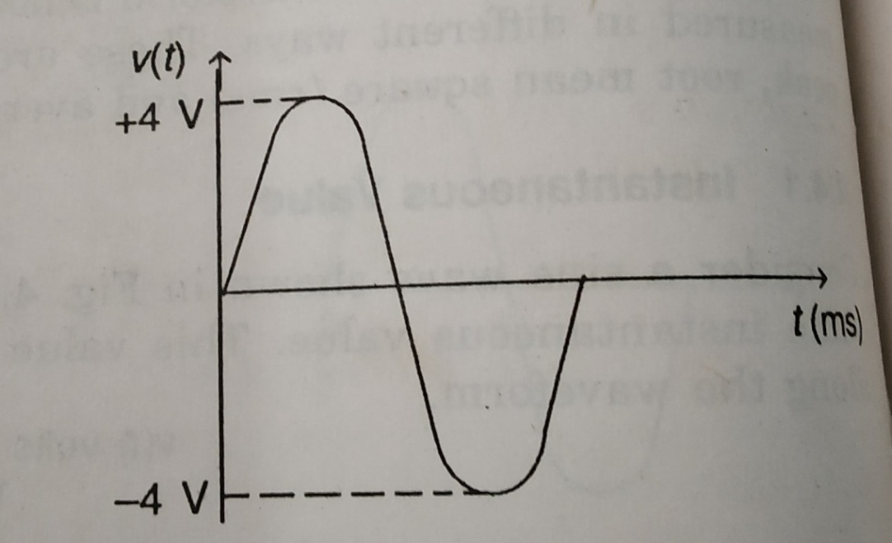
(III) Peak to Peak Value
The peak to peak value of a sine wave is the value from the positive to negative peak.
The peak to peak value of the sine wave is shown in the figure is 8V.
V_{P-P} =2Vm

Slide 13

5.Angular Frequency (ω):
Angular frequency is defined as the number of radians covered in one second(i.e the angle covered by the rotating coil).
The unit of angular frequency is rad/sec.

Slide 14
Problem :
1. An alternating current i is given by
i = 141.4 sin 314t
Find i) The maximum value
ii) Frequency
iii) Time Period
iv) The instantaneous value when t=3ms
Solution: i = 141.4 sin 314t
Maximum value Im=141.4 V
ω = 314 rad/sec
f = ω/2∏ = 50 Hz
T=1/f = 0.02 sec
i =141.4 sin(314x0.003) = 114.35A

Slide 15
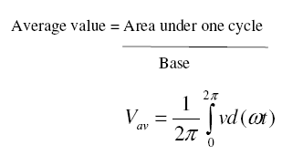
Average Value :
The arithmetic average of all the values of an alternating quantity over one cycle is called its average value
Note: For Symmetrical waveforms, the average value calculated over one cycle becomes equal to zero because the positive area cancels the negative area.
Hence for symmetrical waveforms, the average value is calculated for half cycle.

Slide 16
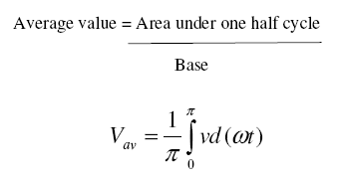
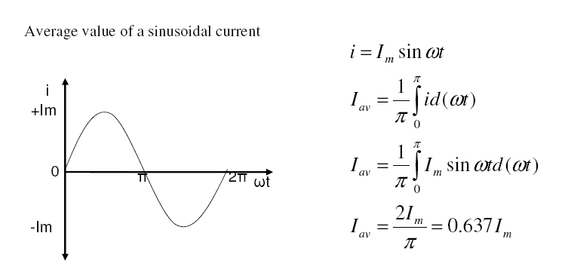

Slide 17
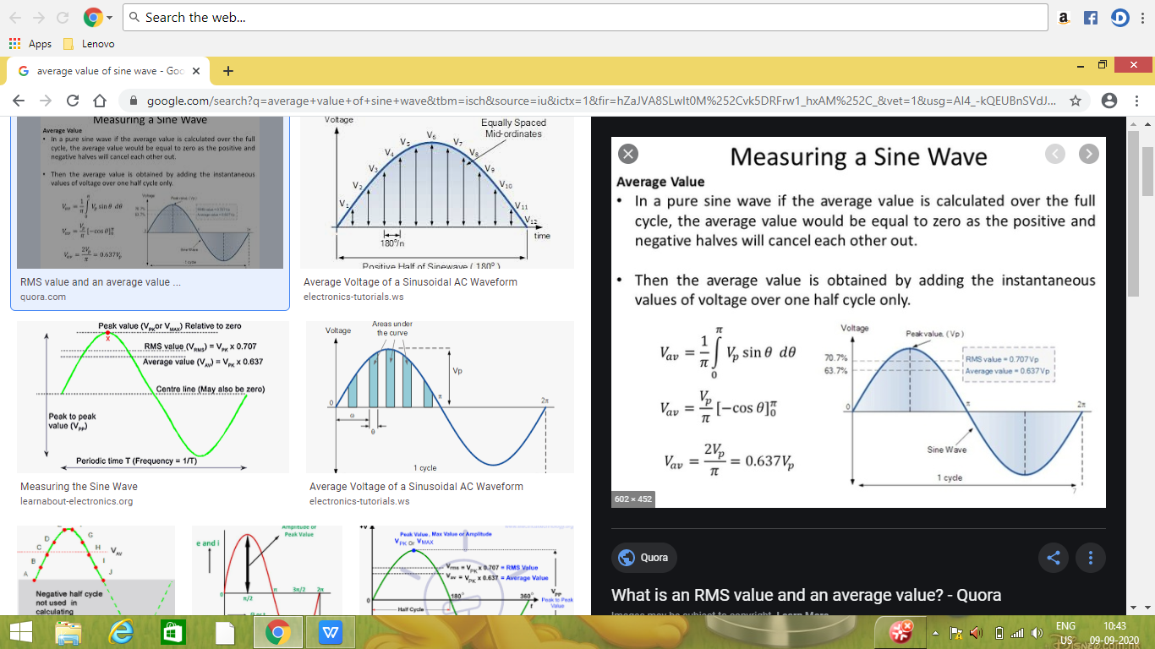
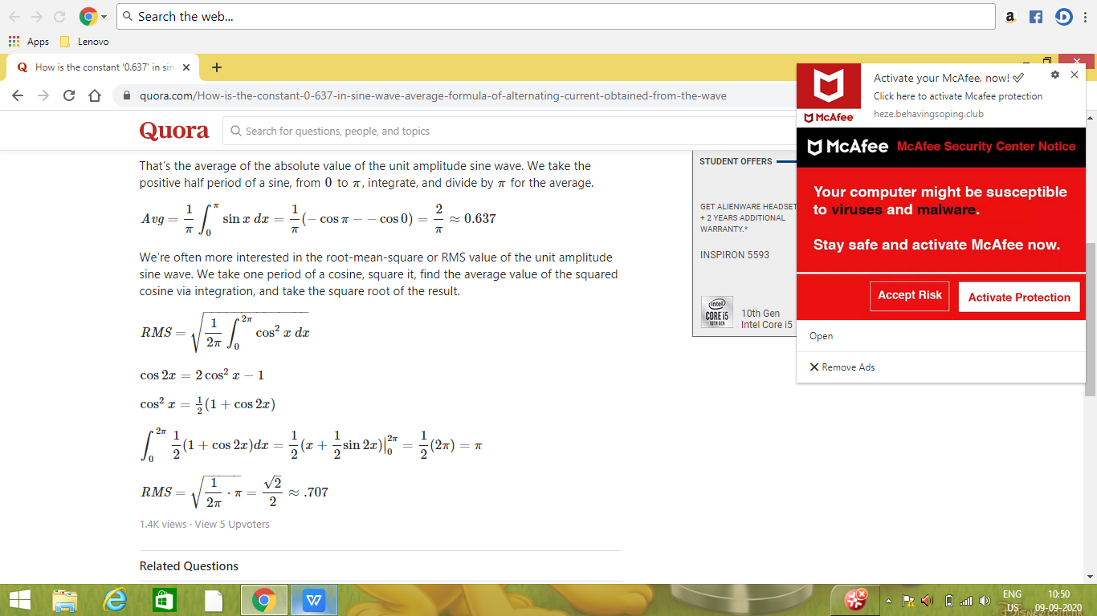

Slide 18
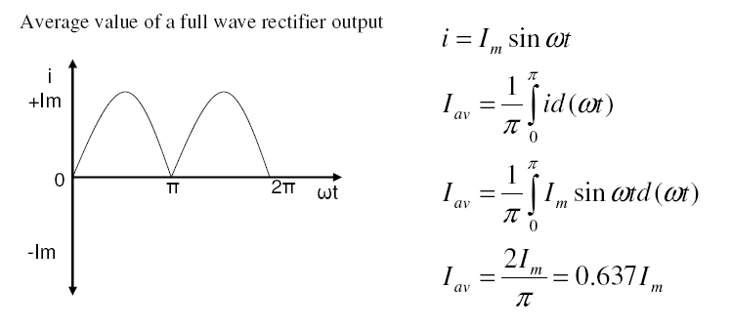
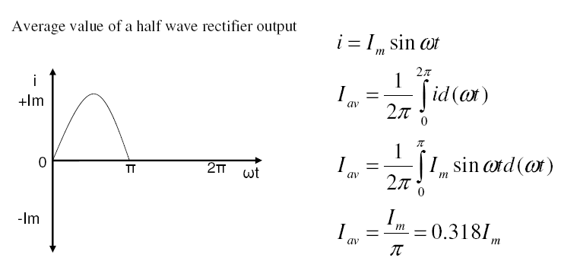

Slide 19
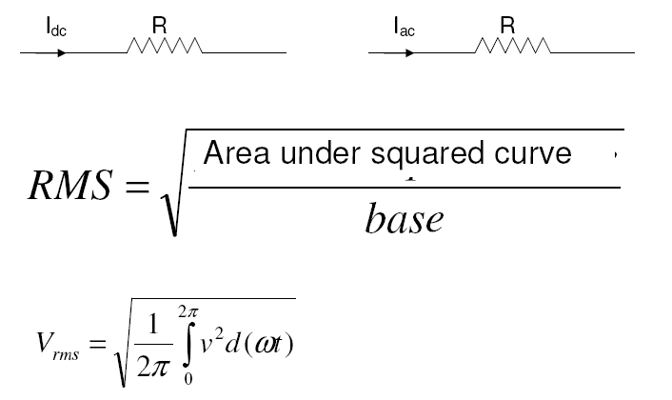
RMS or Effective Value :
The effective or RMS value of an alternating quantity is that steady current (dc) which when flowing through a given resistance for a given time produces the same amount of heat produced by the alternating current flowing through the same resistance for the same time.

Slide 20
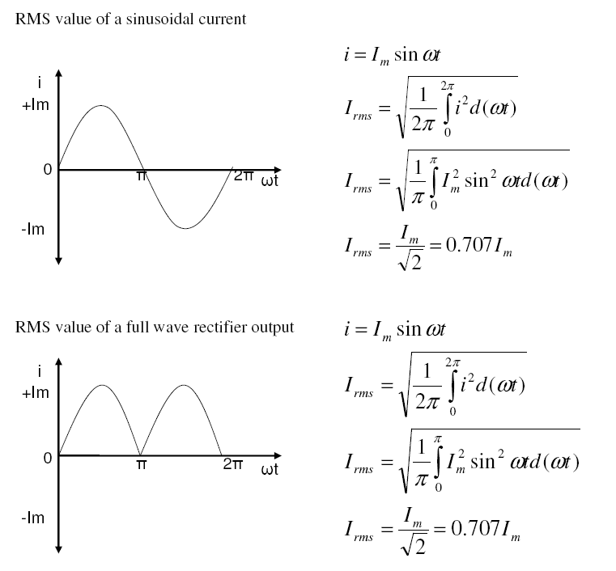

Slide 21
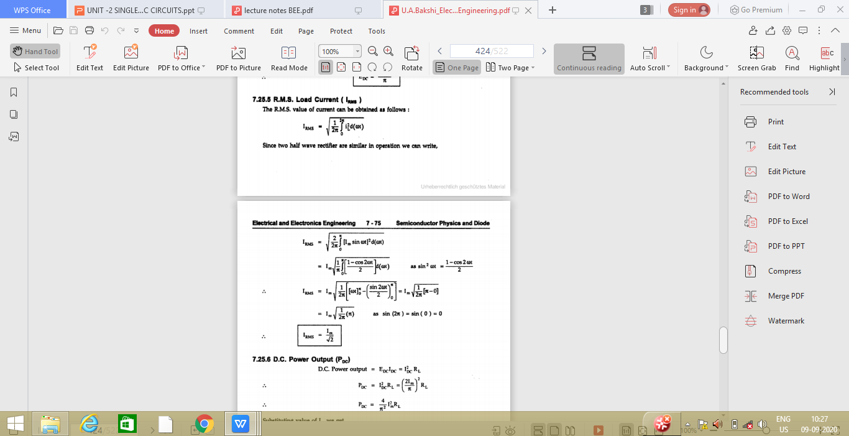

Slide 22
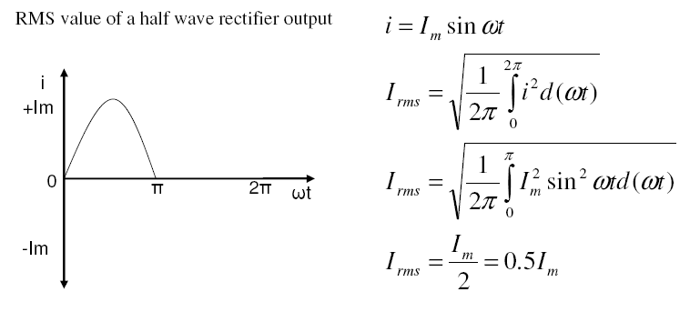

Form Factor :
The ratio of RMS value to the average value of an alternating quantity is known as Form Factor

Slide 23

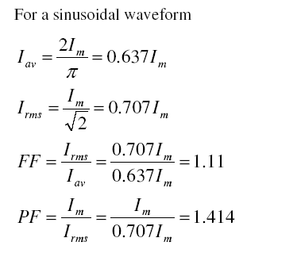
Peak Factor or Crest Factor :
The ratio of maximum value to the RMS value of an alternating quantity is known as the peak factor

Slide 24
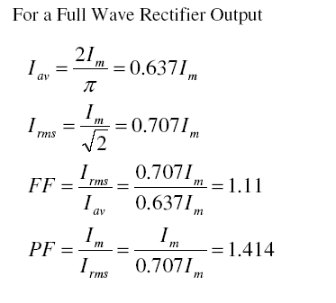
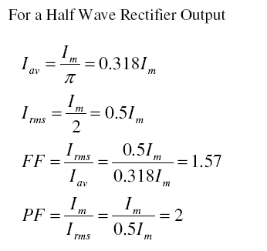

Slide 25
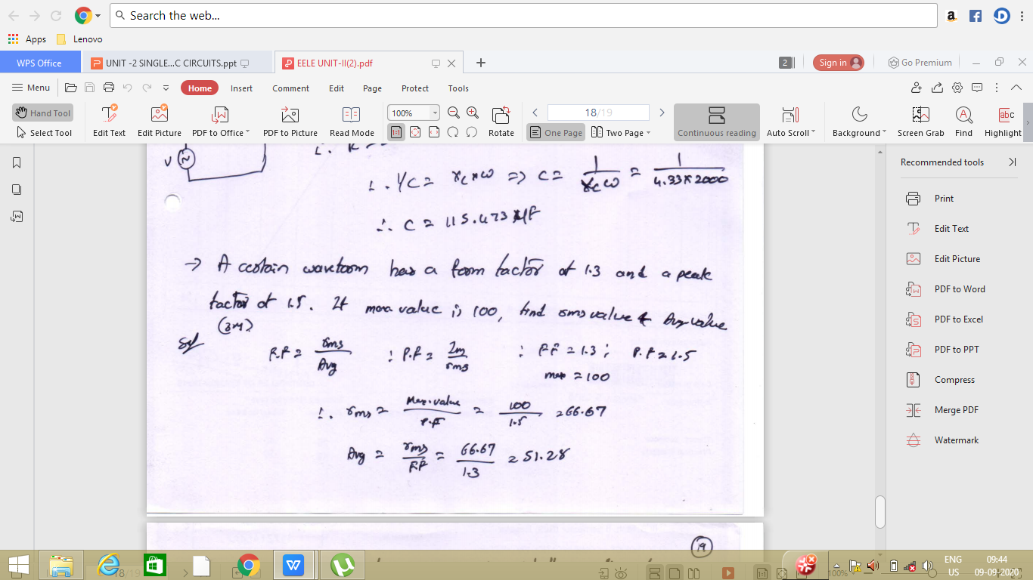

Slide 26
Problem 1: A sine wave has a peak value of 25 V. Determine the following values (i) rms (ii) Peak to peak (iii) Average (iv) Form factor and (v) Peak factor.
ans
peak value =25 V.
(i) rms=0.707*25=17.625v
(ii) Peak to peak =25+25=50v
(iii) Average =0.637*25=15.925v
(iv) Form factor =1.11
(v) Peak factor=1.414

Slide 27
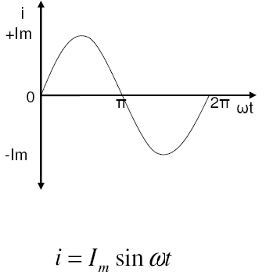
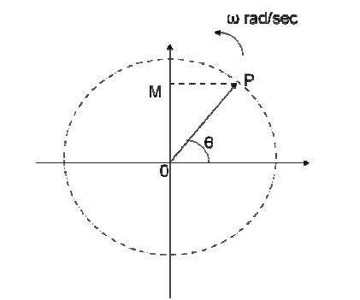
Phasor Representation :
An alternating quantity can be represented using
(i) Waveform
(ii) Equations
(iii) Phasor
A sinusoidal alternating quantity can be represented by a rotating line called a Phasor. A phasor is a line of definite length rotating in anticlockwise direction at a constant angular velocity

Slide 28
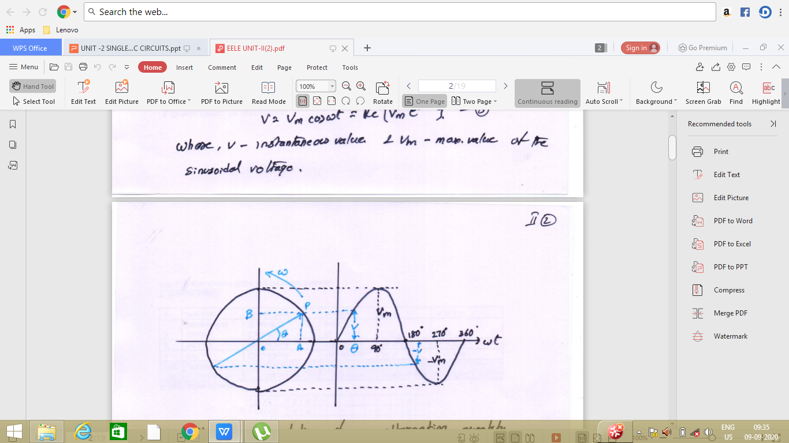

Slide 29
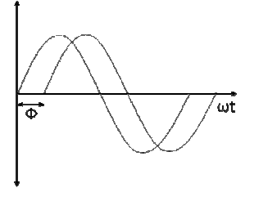
Phase Difference :
When two alternating quantities of the same frequency have different zero points, they are said to have a phase difference. The angle between the zero points is the angle of phase difference.

Slide 30
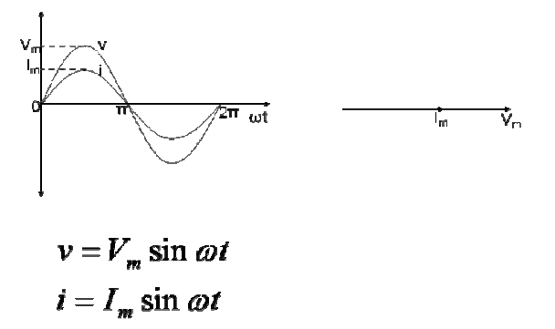
In Phase :
Two waveforms are said to be in phase, when the phase difference between them is zero. That is the zero points of both the waveforms are same.
The figure shows that the voltage and current are in phase.

Slide 31
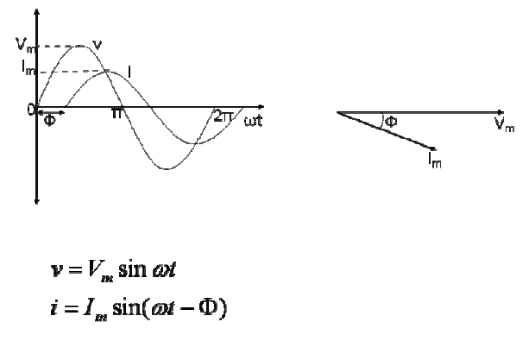
Lagging :
In the figure shown below, the zero point of the current waveform is after the zero point of the voltage waveform. Hence the current is lagging behind the voltage. The waveform, phasor and equation representation is as shown.

Slide 32
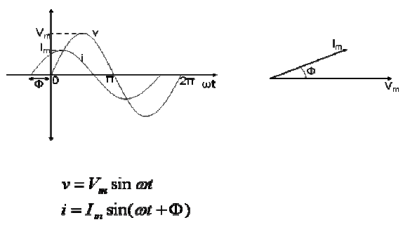
Leading :
In the figure shown below, the zero point of the current waveform is before the zero point of the voltage waveform. Hence the current is leading the voltage. The waveform, phasor and equation representation is as shown.

Slide 33
